Slide 1

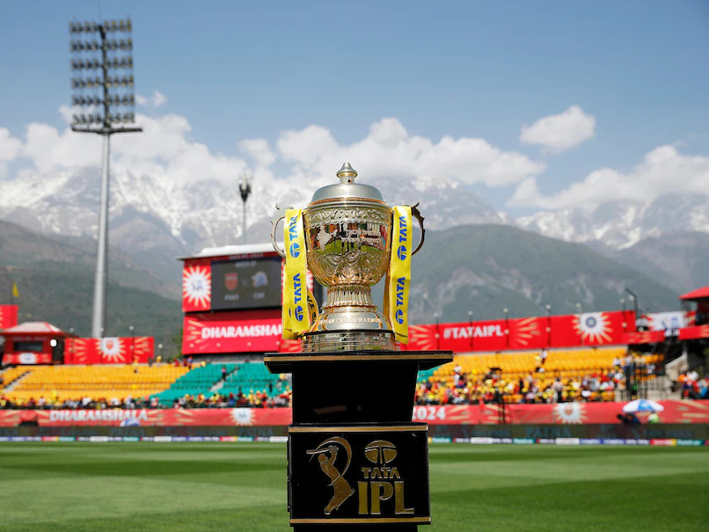
IPL CAPTONE
GDH

Slide 2
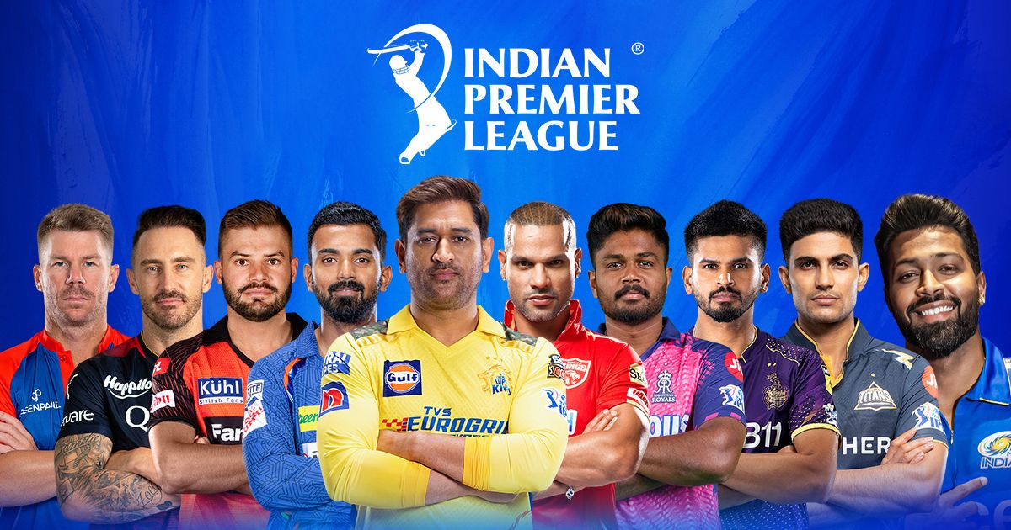
LARANA CLUB
The Indian Premier League (IPL) is a professional Twenty20 cricket league in India. Founded in 2008 by the Board of Control for Cricket in India (BCCI), it features teams representing different Indian cities. The IPL is one of the most popular and lucrative cricket leagues globally, attracting top players and massive viewership.

Slide 3

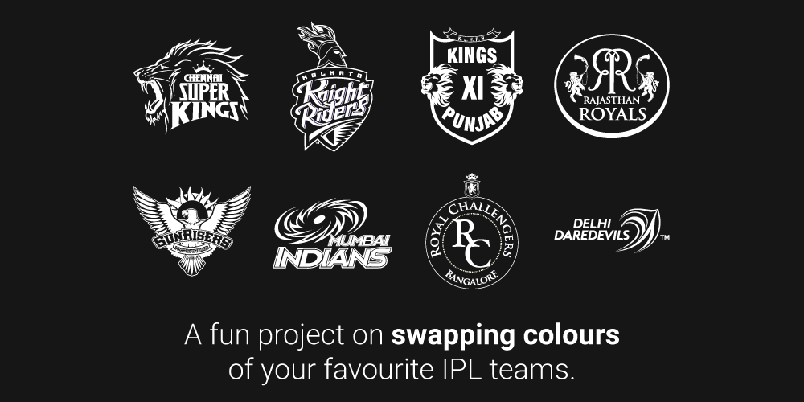
IPL HISTORY
The Indian Premier League (IPL) began in 2008 with eight teams. Over the years, the league has seen several changes in team composition, including the introduction of new teams and the termination or rebranding of existing ones. The most successful teams in IPL history are Mumbai Indians and Chennai Super Kings, each having won the title five times.

Slide 4



LARANA CLUB
ABOUT OF CAPSTONE USING THE TOOL

Slide 5
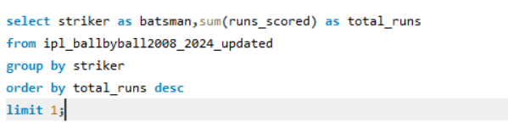
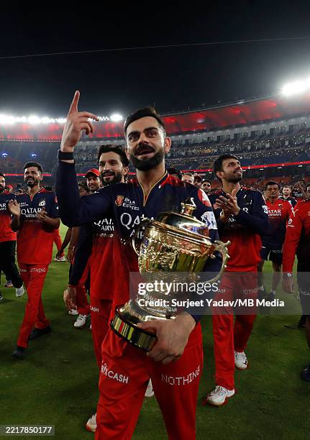
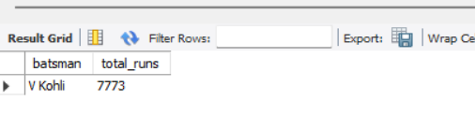
#1 Which batsman has scored the highest total runs?
YOUR PARAGRAPH TEXT

Slide 6
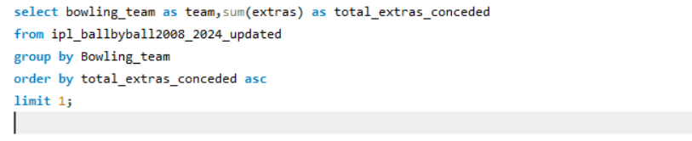

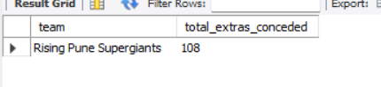
#2 Which team has conceded the least extras in the matches?

Slide 7
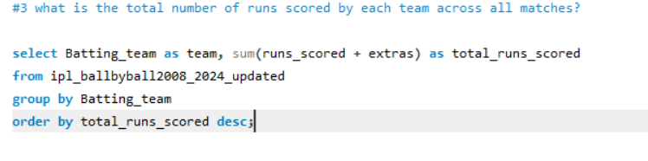
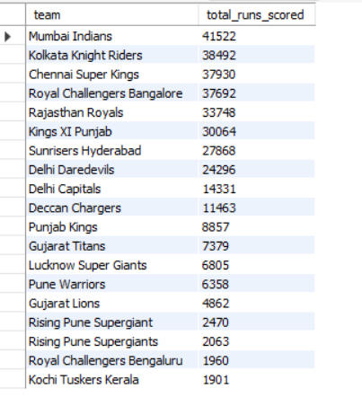

Slide 8
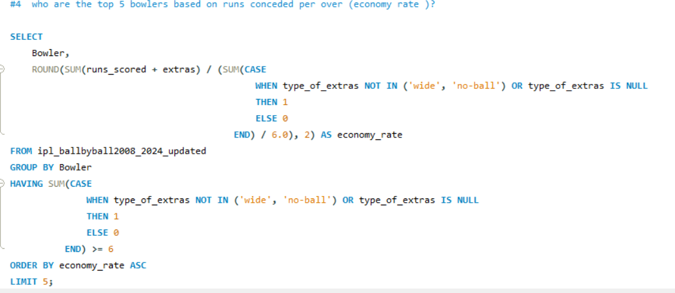
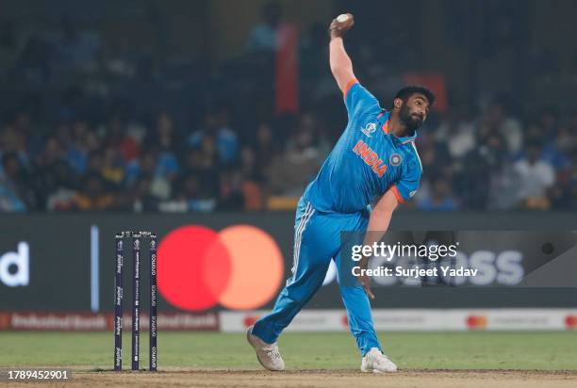
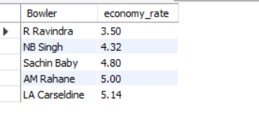

Slide 9
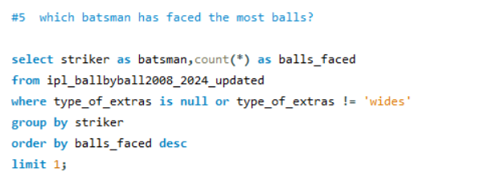
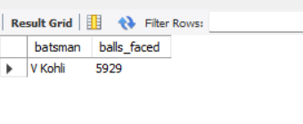

Slide 10

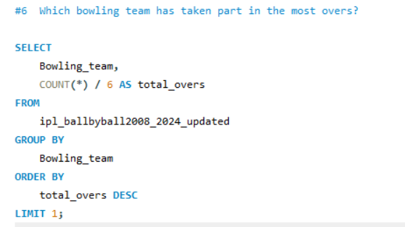

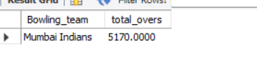

Slide 11
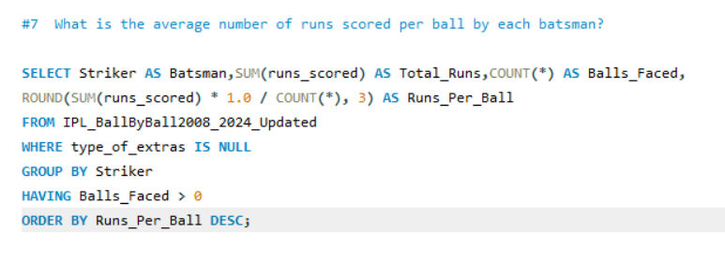
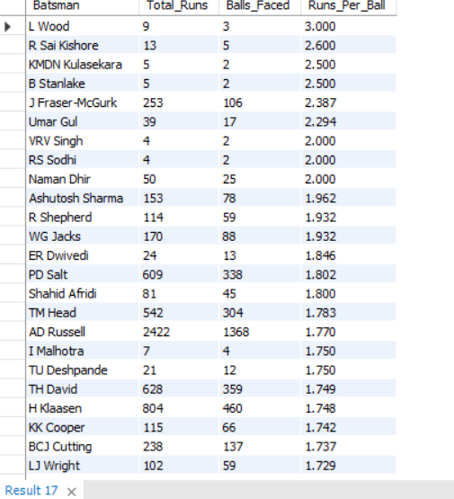
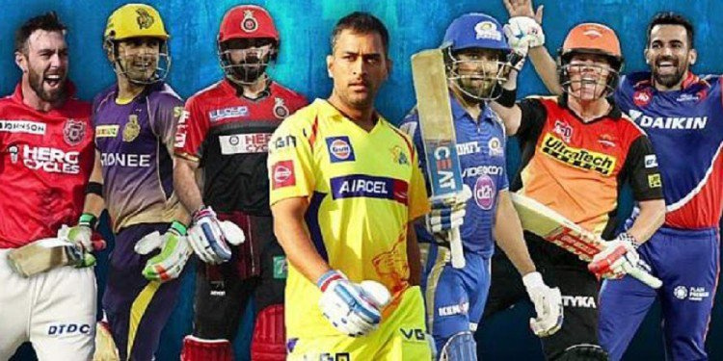

Slide 12
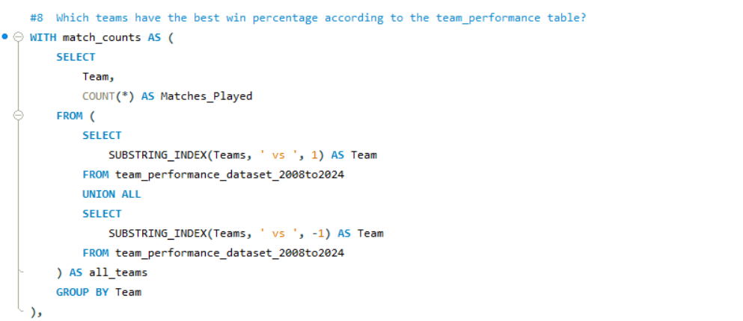
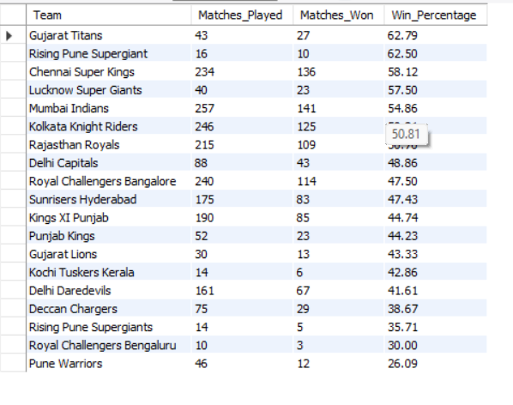
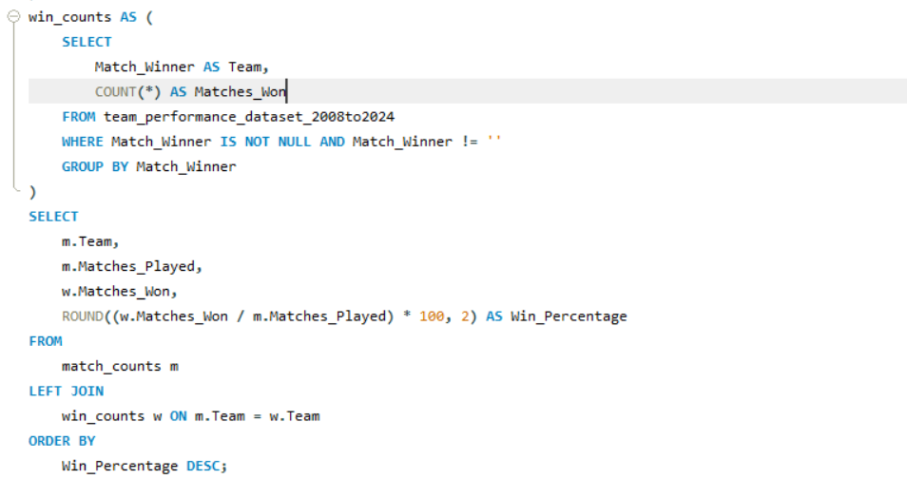

Slide 13
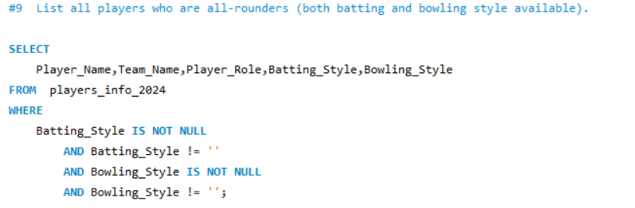
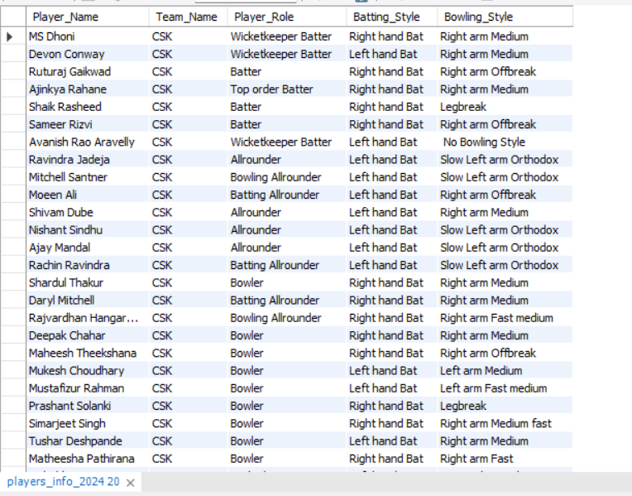

Slide 14
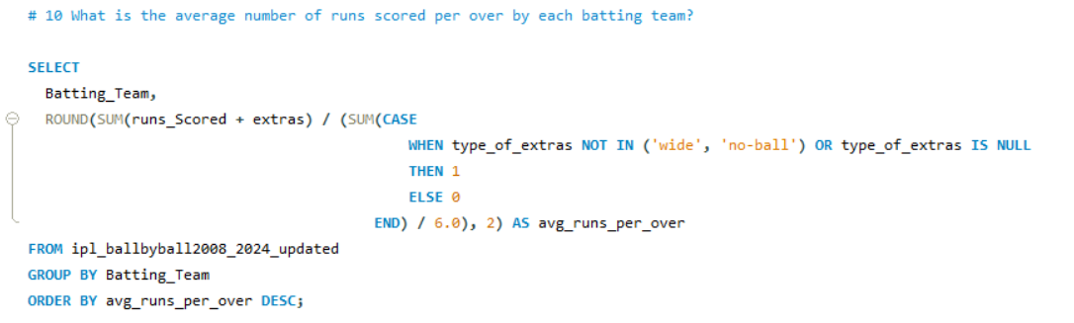
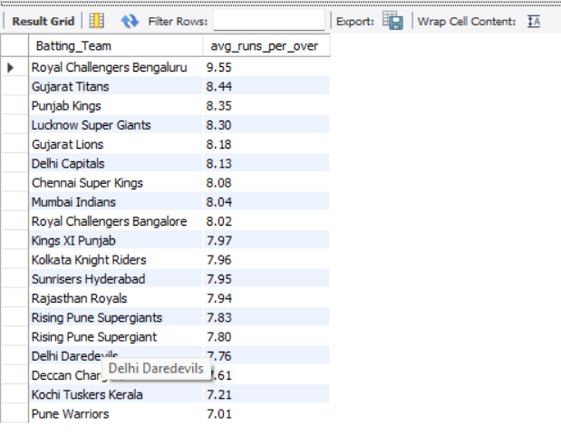

Slide 15


Slide 16
About
power bi
Power BI is a business intelligence platform developed by Microsoft, designed to transform data into interactive dashboards and reports. It allows users to connect to various data sources, visualize data through charts and graphs, and share insights across an organization. Power BI also incorporates AI-powered features for data analysis and report creation.

Slide 17
Dashboard 1: Season Highlights
Matches played per season
Winner & runner-up teams
Total runs scored by season
Number of sixes/fours per season
Average winning margin (runs/wickets)
Dashboard 2: Team Performance
Team-wise win percentage
Wins by toss decision (bat/field)
Team's match result trends by season
Head-to-head wins/losses
Performance in finals
Dashboard 3: Player Statistics
Top run scorers and average per season
Top wicket takers and economy rates
Most sixes, most boundaries
Player of the Match awards
All-rounder performances
Dashboard 4: Venue Analysis
Top venues by matches played
Venue-wise average scores
Team-wise win % by venue
Toss outcome and result pattern per venue
Home vs away performance
Dashboard 5: Match Situations
Matches won by chasing vs defending
Super Over matches overview
Performance in Powerplay, Middle, Death overs
Fall of wickets timing
Pressure performance: last 5 overs
Dashboard 6: Season-wise Trends
Player participation trend by season
Match totals vs overs comparison
Strike rate evolution over years
Bowling economy trends
Season-level KPI dashboard

Slide 18
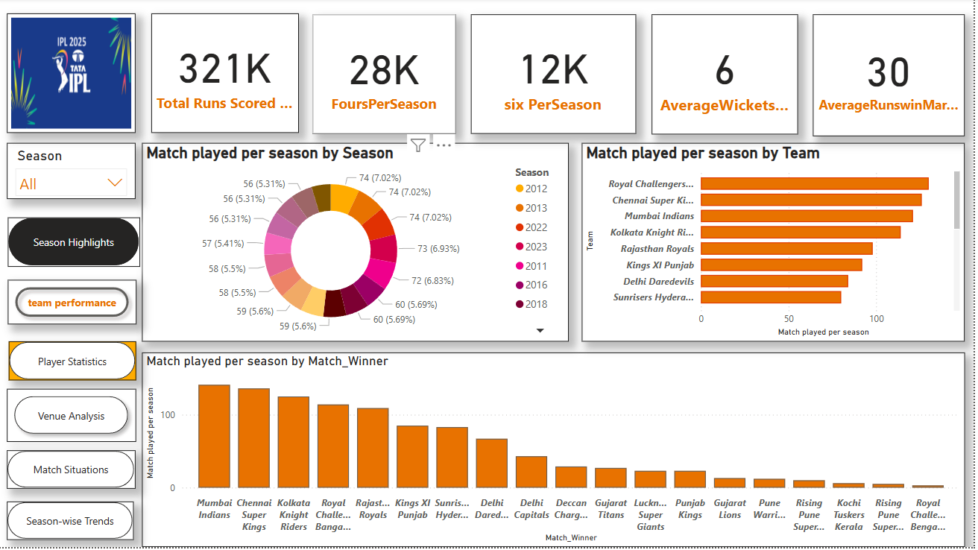
Dashboard 1: Season Highlights

Slide 19
Dashboard 1: Season Highlights
summery
Overall Highlights
Total Runs Scored: 321K
Fours Per Season: 28K
Sixes Per Season: 12K
Average Wickets: 6 per match
Average Runs Win Margin: 30 runs
Match Analysis
📅 Match Played per Season (Donut Chart)
Seasons from 2011 to 2023 are included.
Each season had approximately 56–74 matches.
2012 and 2013 had the highest matches played (74 each).
📂 Dashboard Navigation Buttons
Season Highlights
Team Performance
Player Statistics
Venue Analysis
Match Situations
Season-wise Trends
🏆 Match Played per Season by Match Winners
Top winning teams:
Mumbai Indians
Chennai Super Kings
Kolkata Knight Riders
Royal Challengers Bangalore
🏏 Match Played per Season by Team (Bar Chart)
Top teams with most matches:
Royal Challengers Bangalore
Chennai Super Kings
Mumbai Indians
Kolkata Knight Riders
📌 Key Insight:
Mumbai Indians and Chennai Super Kings continue to dominate across seasons in terms of both matches played and matches won.

Slide 20
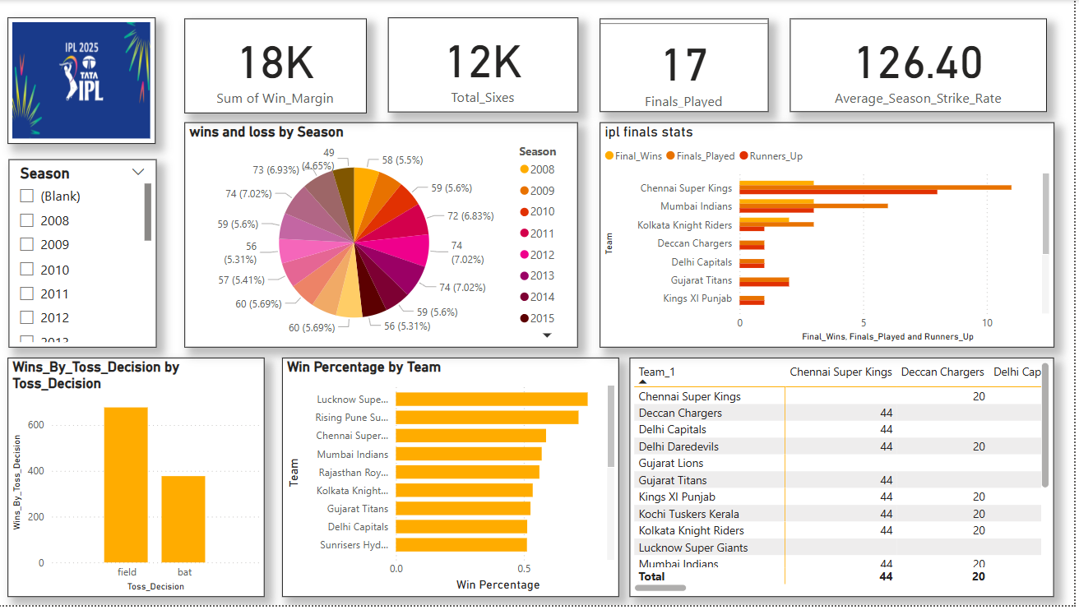
Dashboard 2: Team Performance

Slide 21
Dashboard 2: Team Performance
summery
🏆 IPL Finals Stats:
Chennai Super Kings:
Most Finals Played and Runners-Up finishes
Also among top for Final Wins
🏏 Key Stats (Top Panel):
Total Win Margin (Runs): 18K
Total Sixes: 12K
Finals Played: 17
Average Season Strike Rate: 126.40
📊 Wins and Loss by Season (Donut Chart):
Most seasons had between 56 to 74 matches.
Peak seasons with 74 matches: 2012, 2013, 2014
Other notable seasons: 2008 (58 matches), 2009 (59), 2010 (60), 2015 (56)
Mumbai Indians: Strong in both Final Wins and Finals Played
Kolkata Knight Riders, Deccan Chargers, Delhi Capitals, Gujarat Titans: Moderate presence
Kings XI Punjab: No final wins
📈 Win Percentage by Team:
Top Win Percentages:
Lucknow Super Giants
Rising Pune Supergiants
Chennai Super Kings
Other strong teams include:
Mumbai Indians, Rajasthan Royals, KKR
Lower win percentages for: Sunrisers Hyderabad, Delhi Capitals
Toss Decisions & Wins:
Teams winning the toss and choosing to field have won more than 600 matches
Teams choosing to bat after winning toss have won fewer than 400 matches
🔸 Fielding after toss win appears to be a more successful strategy.
📋 Team Match Records Table:
All teams listed with a constant figure of 44 matches played.
Chennai Super Kings listed again with 20 final appearances.

Slide 22
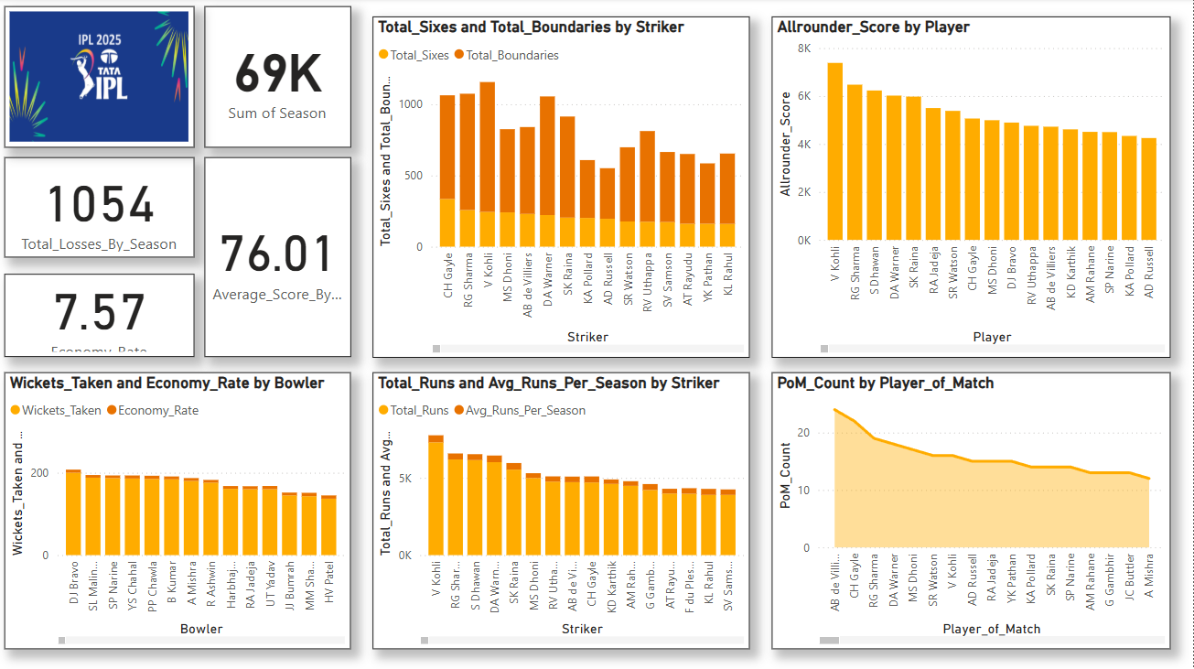
Dashboard 3: Player Statistics

Slide 23
Dashboard 3: Player Statistics
summery
🔢 General Stats:
Total Matches Played (Sum of Season): 69,000
Total Losses by Season: 1,054
Average Score by Season: 76.01
Average Economy Rate: 7.57
🏏 All-Rounder Performance:
Top Allrounder Score:
V Kohli again leads.
Close contenders: RG Sharma, S Dhawan, DA Warner, SK Raina.
💥 Batting Performance:
Total Sixes and Boundaries by Striker:
CH Gayle leads in total sixes and boundaries.
Other top hitters: RG Sharma, V Kohli, MS Dhoni, AB de Villiers.
Total Runs and Average Runs per Season:
V Kohli tops both total runs and average per season.
Followed by RG Sharma, S Dhawan, DA Warner, and MS Dhoni.
🎯 Bowling Performance:
Wickets Taken and Economy Rate by Bowler:
DJ Bravo has taken the most wickets.
Other high wicket-takers: SL Malinga, SP Narine, YS Chahal.
Economy rates are also considered but not quantified on the chart.
🏅 Player of the Match (PoM) Awards:
AB de Villiers has received the most Player of the Match awards.
CH Gayle and RG Sharma are next in line.
Key Takeaways:
V Kohli dominates in batting and all-rounder metrics.
CH Gayle stands out as a powerful striker.
DJ Bravo is the leading wicket-taker.
AB de Villiers has a high match-winning impact.

Slide 24
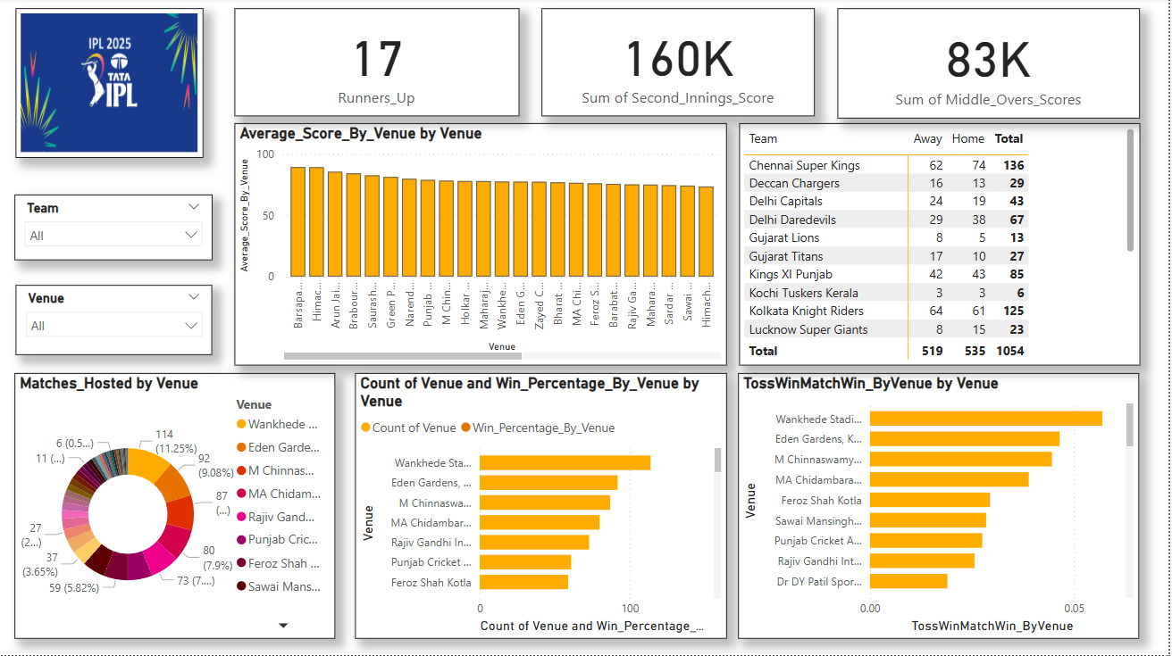
Dashboard 4: Venue Analysis

Slide 25
Dashboard 4: Venue Analysis
summery
🏟 Venue Insights:
1. Average Score by Venue:
Barsapara has the highest average score, followed by Himachal, Arun Jaitley, and Bharat Ratna stadiums.
Most venues show averages in the 70–90 range.
2. Matches Hosted by Venue:
Wankhede Stadium hosted the most matches (114).
Followed by Eden Gardens (92) and M Chinnaswamy (87).
3. Win Percentage by Venue:
Wankhede Stadium has the highest win percentage.
Followed by Eden Gardens, Chinnaswamy, and MA Chidambaram Stadium.
4. Toss Win to Match Win Ratio by Venue:
Again, Wankhede leads, meaning winning the toss here often correlates with winning the match.
Followed by Eden Gardens, Chinnaswamy, and MA Chidambaram.
🏆 Overall Stats:
Runners-Up Count: 17
Sum of Second Innings Scores: 160K
Sum of Middle Overs Scores: 83K
🧢 Team Performance (Total Matches Played):
Chennai Super Kings lead with 136 total matches (62 away, 74 home).
Other high-performing teams:
Kolkata Knight Riders: 125 matches
Kings XI Punjab: 85 matches
Delhi Daredevils: 67 matches
Lowest: Kochi Tuskers Kerala (6) and Lucknow Super Giants (23).
📊 Venue Counts and Win Percentages:
Venues with most match occurrences align with higher win percentages, such as Wankhede, Eden Gardens, and Chinnaswamy.
⚡ Key Takeaways:
Wankhede Stadium is the most influential venue in terms of matches hosted, win rate, and toss-win impact.
Chennai Super Kings are the most consistent team in participation.
Average scores vary by venue, possibly influencing match strategies.
Toss plays a significant role at several high-profile venues.

Slide 26
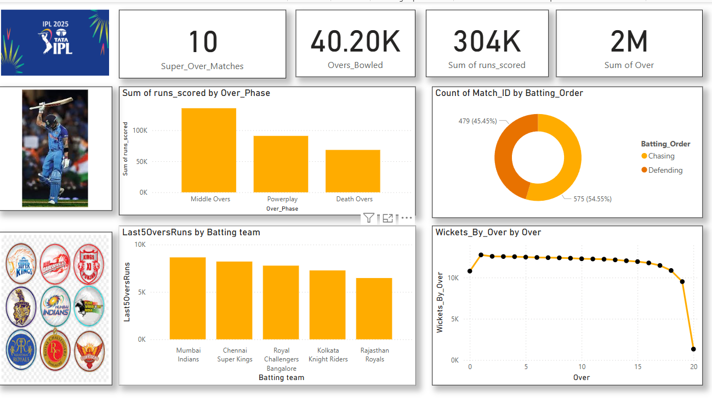
Dashboard 5: Match Situations

Slide 27
Dashboard 5: Match Situations
summery
🔢 Top-Level Stats:
Super Over Matches: 10
Overs Bowled: 40.20K
Total Runs Scored: 304K
Total Overs (All Matches): 2M
📈 Match Count by Batting Order:
Chasing: 575 matches (54.55%)
Defending: 479 matches (45.45%)
➤ Chasing is slightly more frequent than defending in IPL matches.
📊 Sum of Runs Scored by Over Phase:
Middle Overs contributed the most runs, followed by:
Powerplay
Death Overs had the least runs scored
➤ Indicates that scoring tends to stabilize and build in middle overs.
🔥 Last 50 Overs Runs by Batting Team:
Top performers:
Mumbai Indians (highest)
Chennai Super Kings
Royal Challengers Bangalore
Kolkata Knight Riders
Rajasthan Royals (lowest among top 5)
➤ Mumbai Indians lead in recent batting performance.
🧮 Wickets by Over (Line Graph):
Highest number of wickets fall in the first over.
From overs 2 to 17, wicket count remains mostly steady.
Sharp dip at over 20, likely due to fewer balls faced or finishing overs. ➤ Early breakthroughs are common; final overs focus more on runs.

Slide 28
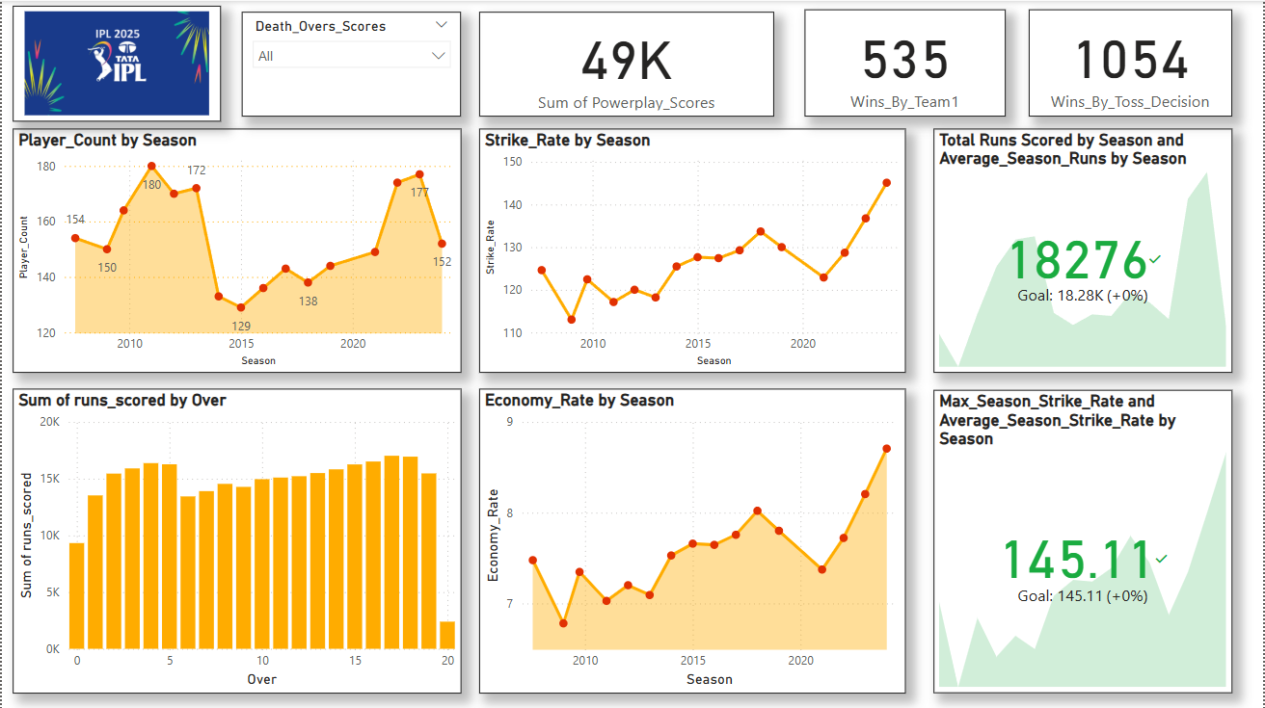
Dashboard 6: Season-wise Trends

Slide 29
Dashboard 6: Season-wise Trends
summery
🏏 Top Stats Overview:
Sum of Powerplay Scores: 49K
Wins by Team1: 535
Wins by Toss Decision: 1054
Total Runs Scored in the Latest Season: 18,276 (Goal met)
Max Season Strike Rate: 145.11
📈 Seasonal Performance Trends:
1. Player Participation (Player_Count by Season):
Peak player participation was 180–180+ around 2012 and 2023–2024.
Lowest count: 129 players around 2014.
Current season shows a drop to 152 players.
2. Strike Rate by Season:
Gradual increase in strike rate over the years.
From ~115 in 2008 to near 145+ in 2025, showing evolving aggressive gameplay.
3. Economy Rate by Season:
Economy rate has also increased from ~6.5 to just under 9 by 2025.
Suggests a more batsman-dominant era with higher scoring.
✅ Goals and Achievements:
Total Runs Goal Achieved: 18,276 (target met).
Max Season Strike Rate Goal Met: 145.11
📊 Batting Dynamics:
Sum of Runs Scored by Over:
Peak scoring occurs between Overs 5–6 and 16–18.
Powerplay (Overs 1–6) and death overs (16–20) contribute heavily to total runs.
Sharp drop at Over 20, as expected.
Strike Rate & Average Runs by Season:
Sharp spike in the last 2–3 seasons, aligning with trends in T20 cricket globally.
Consistent improvement toward 145+ strike rate levels.
Key Takeaways:
IPL 2025 is witnessing record-high strike rates and economy rates, indicating an extremely aggressive batting era.
Powerplay and death overs continue to dominate scoring patterns.
Participation has fluctuated, with recent years again seeing high player counts.
Winning the toss and choosing wisely seems significant with 1054 toss-based wins

Slide 30


Slide 31
ABOUT PYTHON
Python is a high-level, versatile, and widely-used programming language known for its readability and beginner-friendliness. It is often used for web development, data science, automation, and more. Its design emphasizes code clarity, making it easier to learn and use compared to other languages. Python's extensive libraries and frameworks also contribute to its popularity.

Slide 32
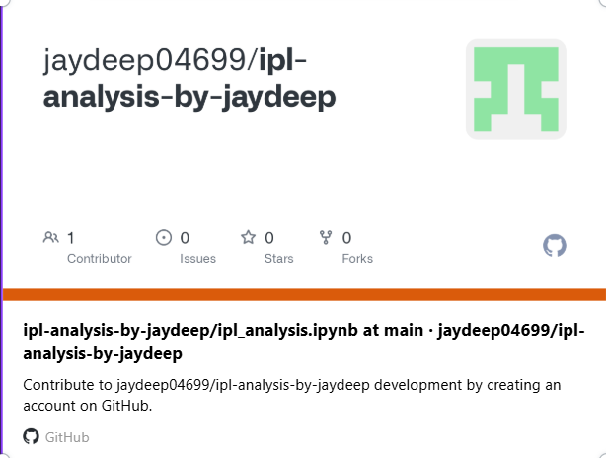
PRESS CTRL+CLICK TO GO THE LINK

Slide 33
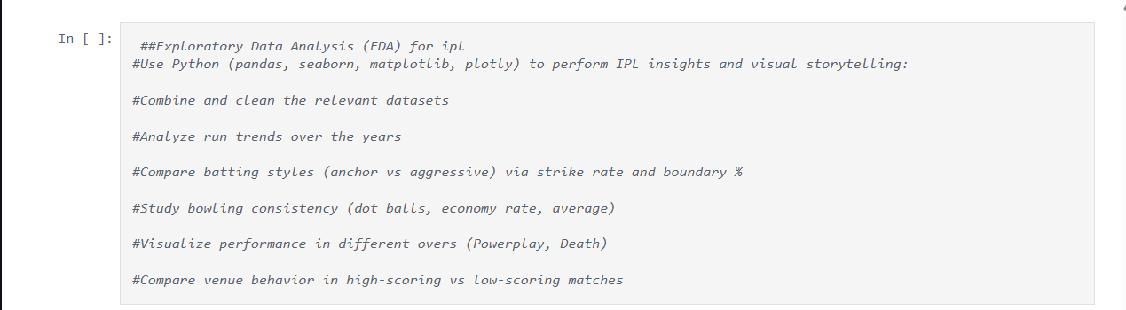
Python: Exploratory Data Analysis (EDA)

Slide 34
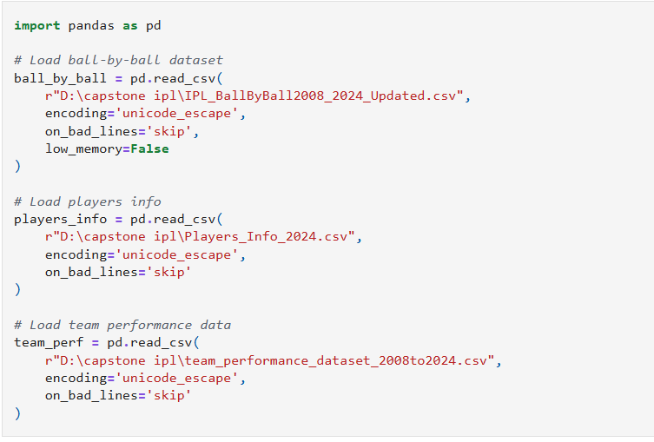

Slide 35
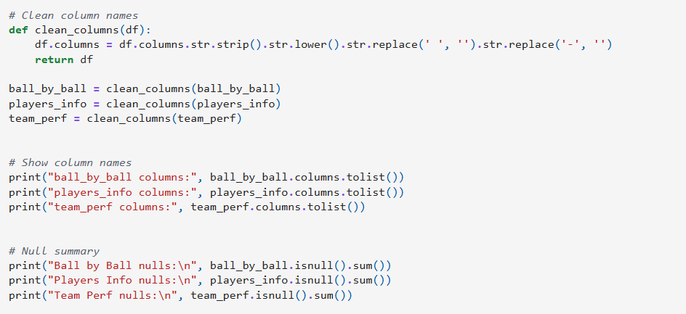

Slide 36
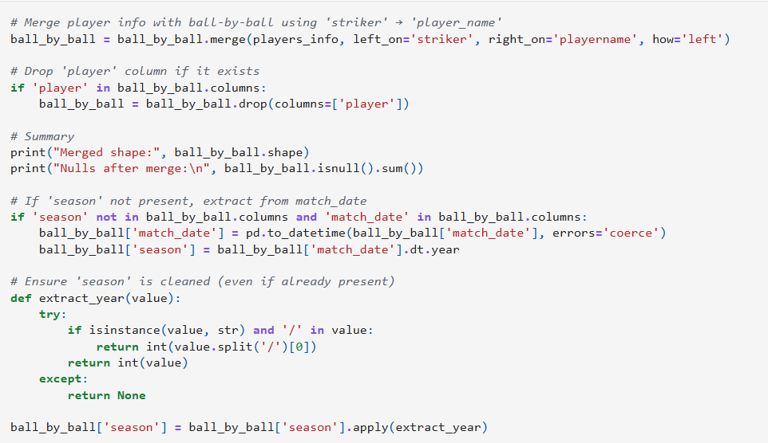

Slide 37
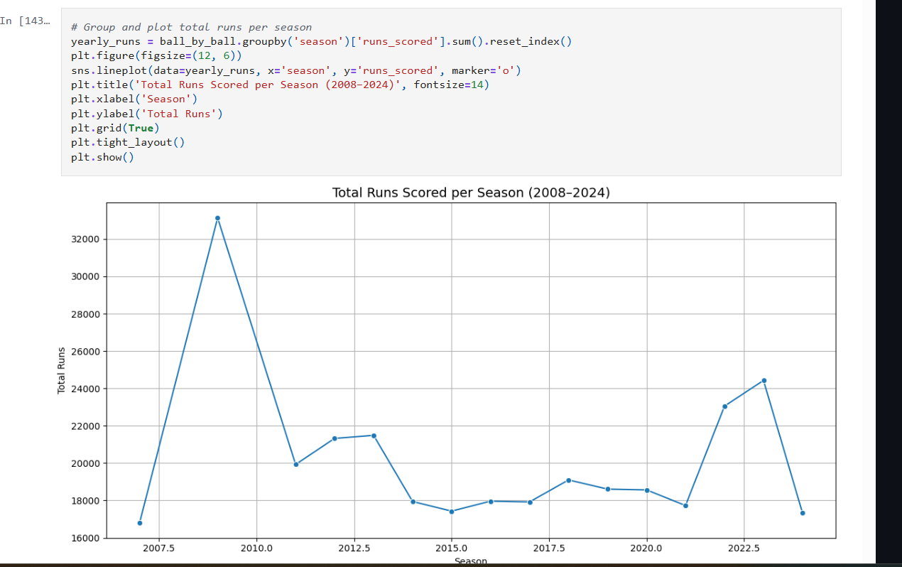

Slide 38
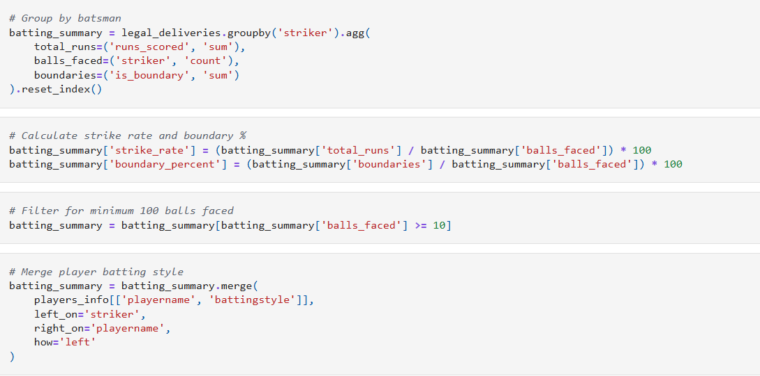

Slide 39
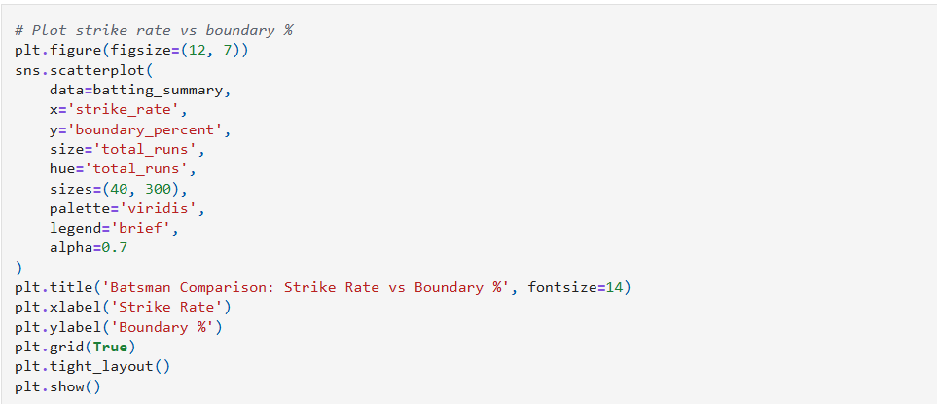

Slide 40
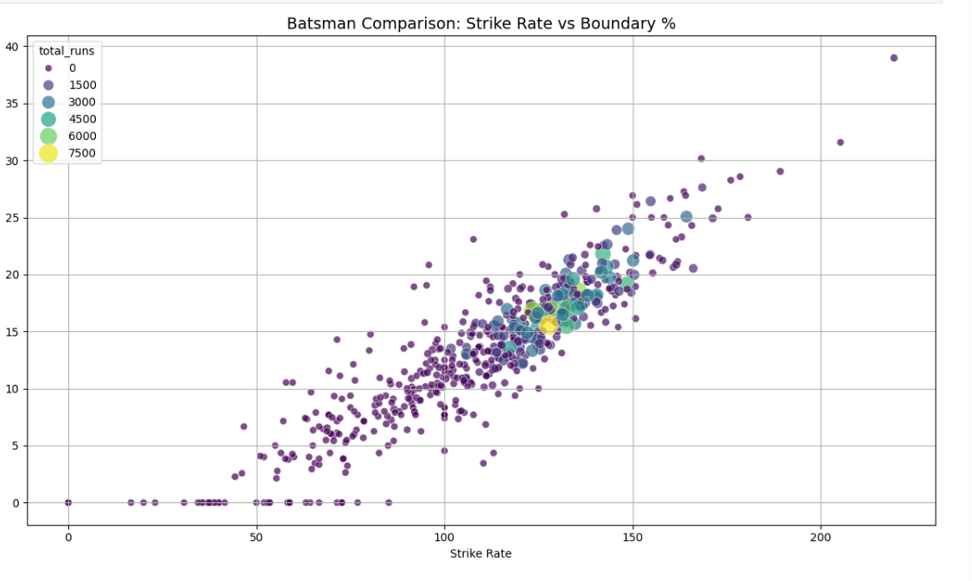

Slide 41
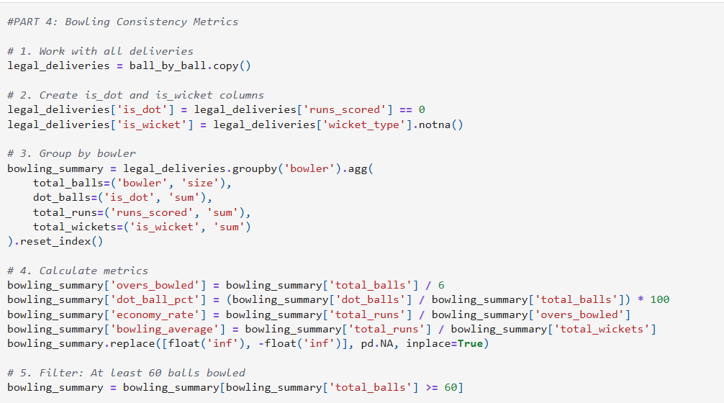

Slide 42
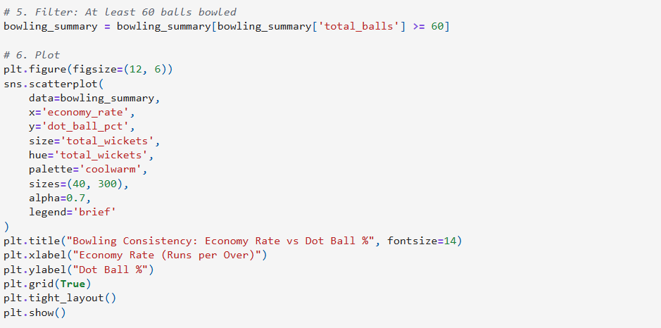

Slide 43
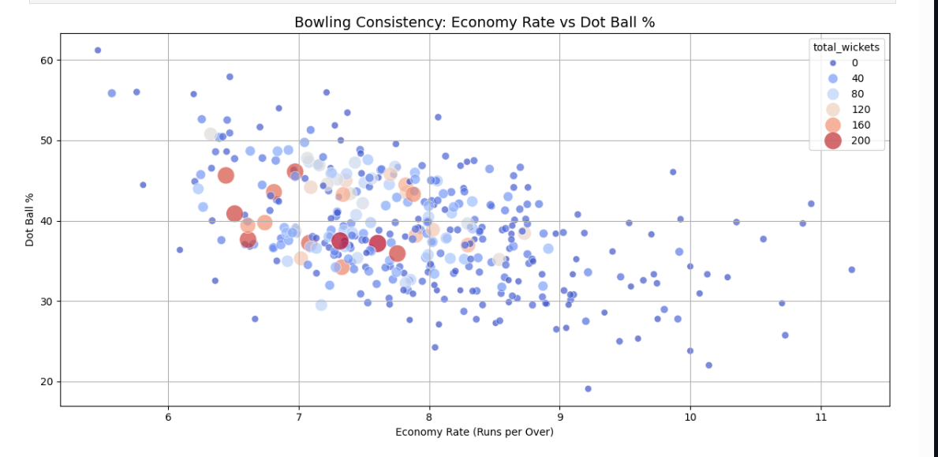

Slide 44
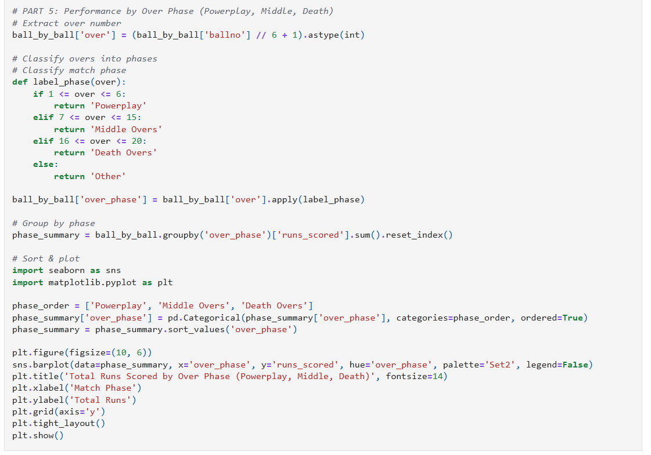

Slide 45
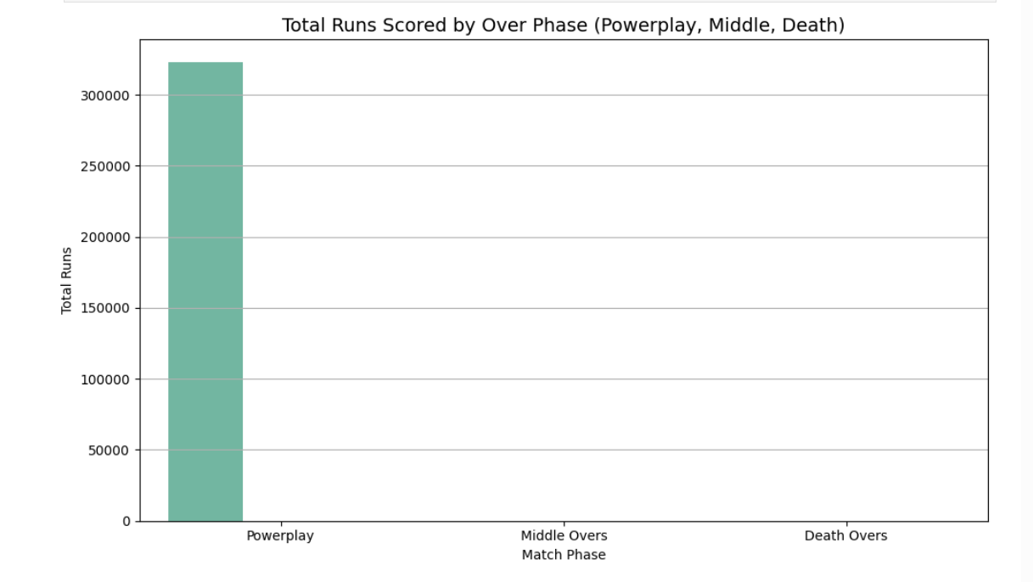

Slide 46
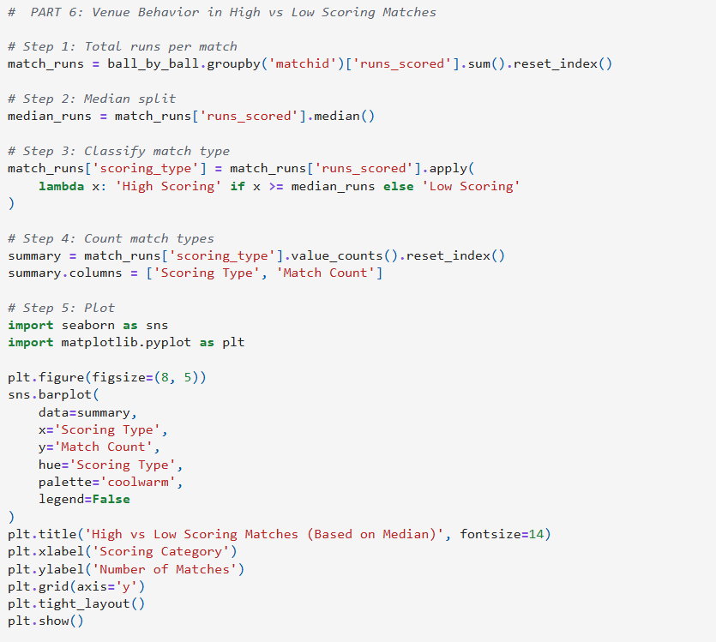

Slide 47
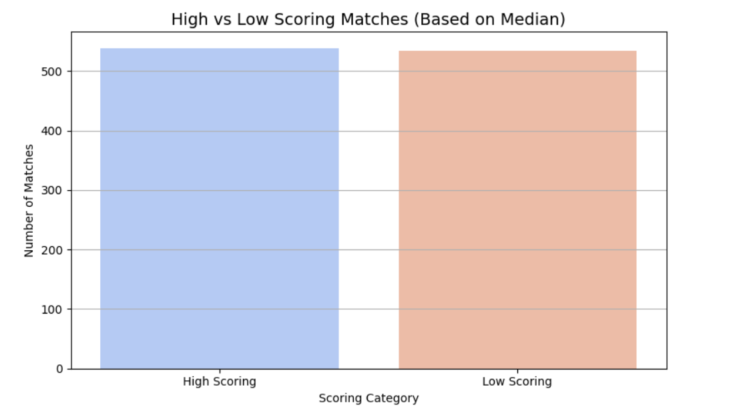

Slide 48
PROJECT DONE BY :JAYDEEP PRAJAPATI

Slide 49
Thank
you!

